Slide 1

Expectation Setting Overview
Subject: Full Stack Development
Sem : 6th Sem
Course Instructor: Shilpa Mangesh Pande, Dr. Susheelamma, Dr. Kanika, Prof VIJYASHANTHI
Notes:
1

Slide 2

Agenda
2
Introduction
Student perspective
Introduction to subject
Why subject is important
Real World Applications
Course Objectives
Pre-requisites
Course Outcomes
CO-PO mapping
Quiz
Textbooks and Reference books
Lesson Plan
Assessment Plan
Experience of past batch students
Expected classroom behavior
Some useful links

Slide 3
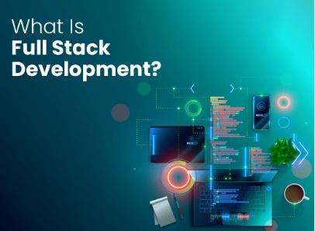
Students perspective
3
Students can introduce themselves
What is your expectation from this course ?

Slide 4
Introduction to subject
4
Full Stack Development requires a diverse skill set that spans both front- end and back-end technologies, as well as an understanding of the entire web development process from concept to deployment.
The FSD key Components:
Front-End Development (HTML, CSS, JavaScript) : Front-end development focuses on the user interface and user experience of a web application.
Back-End Development : It involves building the server-side logic and database management of a web application Reduce cognitive load
Databases (MongoDB, MySQL)
*

Slide 5
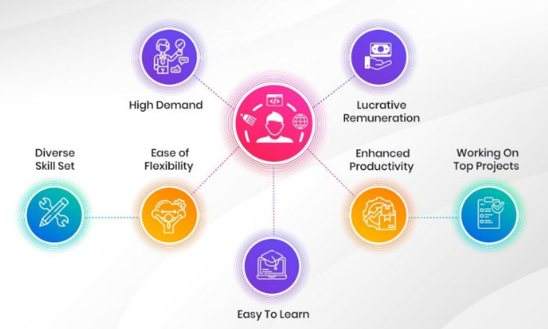
Why Full Stack Development is important?
5
let’s Understand..
Importance of the subject

Slide 6

Real-World Applications
6
Real-world applications examples:
E-Commerce Website and Application
Social Media Website and Application
Content Management System (CMS)
Online Chat Application
Task Management Tool
Blogging Platform
Online Learning Platform

Slide 7
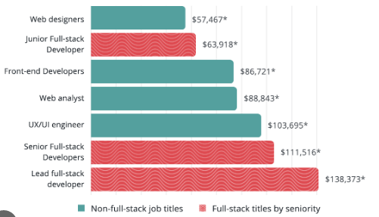
Job Opportunities/Placements
Job Roles:
Devops Engineer
Front-End Developer
Back- end Developer
Quality Assurance Engineer
Web Developer
Full Stack Developer
Web Designer
Mob App Developer

Slide 8
Course Objective
8
To understand the essential javascript concepts for web development. To style Web applications using bootstrap. To utilize React JS to build front end User Interface. To understand the usage of API’s to create web applications using Express JS. To store and model data in a no sql database.

Slide 9
Prerequisite
9
Programming Basics: Understand fundamental programming concepts and have experience with languages like JavaScript, Java. Version Control and Problem-Solving: Proficiency with version control systems like Git, along with strong problem-solving skills, are valuable assets for navigating real-world projects.

Slide 10
Course Outcomes
10
1. Apply Javascript to build dynamic and interactive Web projects . 2. Implement user interface components for JavaScript-based Web using React.JS 3. Apply Express/Node to build web applications on the server side. 4. Develop data model in an open source nosql database. 5. Demonstrate modularization and packing of the front-end modules .

Slide 11
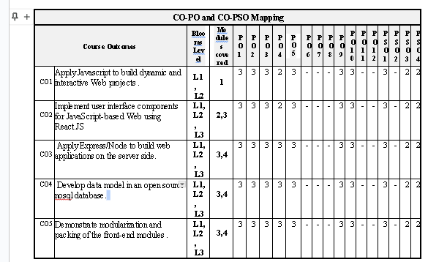
CO-PO mapping
11

Slide 12
Quiz on Cos/expectation setting
12
What are different frontend technologies you worked on?
Have you heard about API’s?
What are the stages in software development life cycle?

Slide 13
Text books and Reference books
13
Text Books
1. Jon Duckett, "JavaScript & jQuery: Interactive Front-End Web Development", Wiley, 2014.
2. Vasan Subramanian, Pro MERN Stack: Full Stack Web App Development with Mongo, Express, React, and Node. Apress, 2019.

Slide 14
Overview of Lesson Plan
14
Module-1 : Basic JavaScript Instructions, Statements, Comments, Variables, Data Types, Arrays, Strings, Functions, Methods & Objects, Decisions & Loops.
Module-2 : Document Object Model: DOM Manipulation, Selecting Elements, Working with DOM Nodes, Updating Element Content & Attributes, Events, Different Types of Events, How to Bind an Event to an Element, Event Delegation, Event Listeners.
Module-3 : Form enhancement and validation. Introduction to MERN: MERN components, Server less Hello world. React Components: Issue Tracker, React Classes, Composing Components, Passing Data Using Properties, Passing Data Using Children, Dynamic Composition.

Slide 15
Overview of Lesson Plan
15
Module-4 :React State: Initial State, Async State Initialization, Updating State, Lifting State Up, Event Handling, Stateless Components, Designing Components, State vs. Props, Component Hierarchy, Communication, Stateless Components. Express, REST API, GraphQL, Field Specification, Graph Based, Single Endpoint, Strongly Typed, Introspection, Libraries, The About API GraphQL Schema File, The List API, List API Integration, Custom Scalar types, The Create API, Create API Integration, Query Variables, Input Validations, Displaying Errors.
Module-5 :MongoDB: Basics, Documents, Collections, Databases, Query Language, Installation, The Mongo Shell, MongoDB CRUD Operations, Create, Read, Projection, Update, Delete, Aggregate, MongoDB Node.js Driver, Schema Initialization, Reading from MongoDB, Writing to MongoDB. Modularization and Webpack ,Back-End Modules Front-End Modules and Webpack Transform and Bundle, Libraries Bundle ,Hot Module Replacement, Debugging DefinePlugin: Build Configuration, Production Optimization.

Slide 16
Assessment Plan
16
Total number of assignments = 02
Each assignment will be given in Last week of March, April
Total number of questions in 1st assignment = 05
Max marks for each assignment = 25 Marks
Total marks assigned for all assignments (2 *25) = 50 Marks
Addition of two assignments will be considered final Assignment marks =25M,Assignment issue dates are mentioned in lesson plan
Min 1 week will be given solve each assignment.
Process of evaluation:
Faculty will evaluate the assignments and marks will be uploaded in the google classroom and it will be shared to students.

Slide 17
Evaluation Method
17
Evaluation Method:
CIE will be evaluated for Every lab for Record and execution of experiments for 10 Marks
Two 50 marks tests will be conducted along with IAT 1, and IAT2 after completing the All the Eight Programs(First Four for IAT-1 and Second four for IAT-2).The same will be scaled down to 15 marks.
CIE +IAT(10+15)=25 Marks

Slide 18
Flip Class details
18
Flipped Classroom process for students to understand | The materials (video, notes, ppt, mcqs) required w.r.t to topics will be shared to the students. Students will be quizzed on the topic shared. The flip will be conducted to check the knowledge, analysis and self-learning capability of the students to answer the questions given.

Slide 19
Expected classroom behaviour
19
Students need to be more attentive during session and respond to questions when required.
Students need to check google class room regularly for ppts, videos, assignment posts and quiz.
All should maintain Assignments with no plagiarism , sticking to deadlines for submissions.
Attendance should be maintained minimum 80% and no disruption (mute mics when not asking question), strict action against abusers of any type of misbehavior.

Slide 20
20
Links to some useful videos :
https://www.youtube.com/watch?v=jBzwzrDvZ18
https://www.youtube.com/watch?v=rHux0gMZ3Eg
https://www.coursera.org/lecture/html-css-javascript-for-web-developers/lecture-18-part-2-styling-text- BMeuN

Slide 21
21
Thank
You!

